Slide 1


Noida Institute of Engineering and Technology, Greater Noida
Text Analysis and Similarity
Unit: 3
Natural Language Processing
Subject Code: ACSAI0712
Mr. M. Abdul Mateen Siddiqui
(Assistant Professor)
Department of CSE (Cyber Security)
Course Details B. Tech. VII Sem

Slide 2
Faculty Introduction
Name : Mr. M. Abdul Mateen Siddiqui
Qualification: B. Tech (CSE), M. Tech (CSE-CFIS), Ph. D (Pursuing)
Area of Specialization: Cyber Forensics, Information Security, Digital Forensics, Smart Wearable Devices and IoT Devices

Slide 3
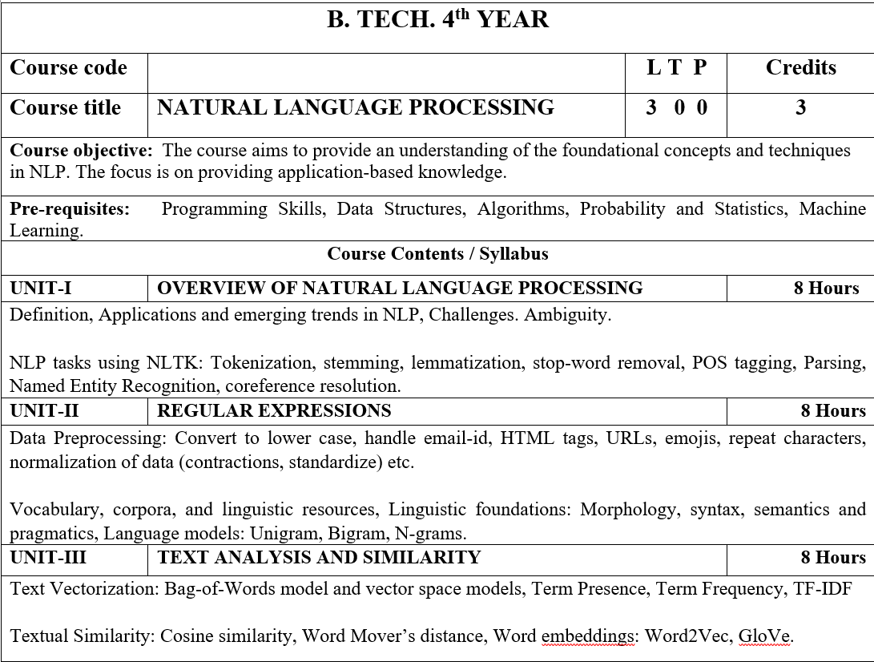
Syllabus

Slide 4
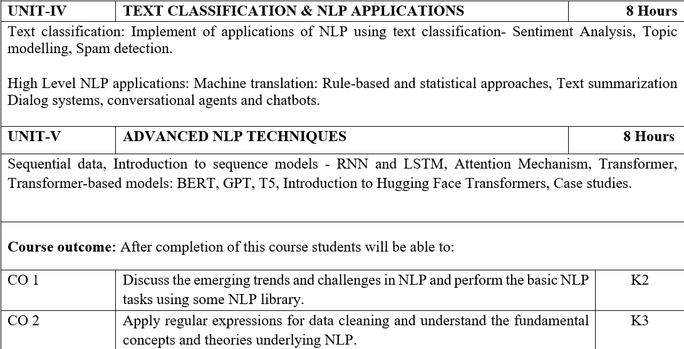
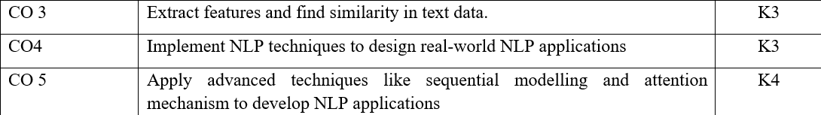
Syllabus

Slide 5
Video Links
https://realpython.com/nltk-nlp-python/
https://www.coursera.org/lecture/python-text-mining/basic-nlp-tasks-with-nltk-KD8uN
https://www.coursera.org/lecture/nlp-sequence-models/learning-word-embeddings-APM5s
https://www.coursera.org/projects/regular-expressions-in-python
https://www.coursera.org/learn/python-text-mining/lecture/sVe8B/regular-expressions

Slide 6
Course Objective
The course aims to provide an understanding of the foundational concepts and techniques in NLP.
The focus is on providing application-based knowledge.

Slide 7
Course Outcome
CO1 | Discuss the emerging trends and challenges in NLP and perform the basic NLP tasks using some NLP library. | K2
CO2 | Apply regular expressions for data cleaning and understand the fundamental concepts and theories underlying NLP. | K3
CO3 | Extract features and find similarity in text data. | K3
CO4 | Implement NLP techniques to design real-world NLP applications | K3
CO5 | Apply advanced techniques like sequential modelling and attention mechanism to develop NLP applications | K4

Slide 8
Program Outcome
1. Engineering knowledge: Apply the knowledge of mathematics, science, engineering fundamentals, and an engineering specialization for the solution of complex engineering problems.
2. Problem analysis: Identify, formulate, research literature, and analyze complex engineering problems reaching substantiated conclusions using first principles of mathematics, natural sciences, and engineering sciences.
3. Design/development of solutions: Design solutions for complex engineering problems and design system components or processes that meet the specified needs with appropriate consideration for public health and safety, and cultural, societal, and environmental considerations.

Slide 9
Program Outcome
4. Conduct investigations of complex problems: Use research based knowledge and research methods including design of experiments, analysis and interpretation of data, and synthesis of information to provide valid conclusions.
5. Modern tool usage: Create, select, and apply appropriate techniques, resources, and modern engineering and IT tools, including prediction and modeling to complex engineering activities, with an understanding of the limitations.
6. The engineer and society: Apply reasoning informed by the contextual knowledge to assess societal, health, safety, legal and cultural issues and the consequent responsibilities relevant to the professional engineering practice.

Slide 10
Program Outcome
7. Environment and sustainability: Understand the impact of the professional engineering solutions in societal and environmental contexts, and demonstrate the knowledge of, and need for sustainable development.
8. Ethics: Apply ethical principles and commit to professional ethics and responsibilities and norms of the engineering practice.
9. Individual and team work: Function effectively as an individual, and as a member or leader in diverse teams, and in multidisciplinary settings.

Slide 11
Program Outcome
10. Communication: Communicate effectively on complex engineering activities with the engineering community and with the society at large, such as, being able to comprehend and write effective reports and design documentation, make effective presentations, and give and receive clear instructions.
11. Project management and finance: Demonstrate knowledge and understanding of the engineering and management principles and apply these to one’s own work, as a member and leader in a team, to manage projects and in multidisciplinary environments.
12.Life-long learning: Recognize the need for, and have the preparation and ability to engage in independent and life-long learning in the broadest context of technological change.

Slide 12
Pre-requisites
Programming Skills,
Data Structures,
Algorithms,
Probability and Statistics,
Machine Learning.

Slide 13
Unit-3:Content
TEXT ANALYSIS AND SIMILARITY:
Text Vectorization:
Bag-of-Words Model
Vector Space Models
Term Presence
Term Frequency
TF-IDF
Textual Similarity:
Cosine Similarity
Word Mover’s Distance
Word Embeddings:
Word2Vec
GloVe

Slide 14
What is Text Analysis?
Text analysis, also known as text mining or text analytics.
It is the process of extracting useful information, patterns, and insights from unstructured text data.
It involves various techniques and methods to transform raw text into structured and meaningful information that can be used for decision-making, information retrieval, and knowledge discovery.
Text Analysis can be applied to a wide range of text sources, including documents, social media posts, emails, customer reviews, news articles, and more.

Slide 15
Goals of Text Analysis:
Text Preprocessing: This involves cleaning and preparing text data for analysis. It includes tasks like tokenization (splitting text into words or phrases), removing punctuation, converting text to lowercase, and handling issues like stopwords (common words like "and," "the," "is" that are often removed because they don't carry significant meaning) and stemming (reducing words to their root form).
Text Classification: Text classification involves categorizing text data into predefined classes or categories. Common examples include spam email detection, sentiment analysis (classifying text as positive, negative, or neutral), and topic classification.
Named Entity Recognition (NER): NER is the process of identifying and classifying entities (such as names of people, organizations, locations, dates, etc.) within text. It is essential for information extraction and can be used in applications like news article summarization and entity linking.
Sentiment Analysis: Sentiment analysis, also known as opinion mining, determines the sentiment or emotional tone expressed in a piece of text. It's often used to gauge public opinion on products, services, or topics by classifying text as positive, negative, or neutral.
Text Clustering: Text clustering groups similar documents or pieces of text together based on their content. This is useful for organizing large collections of text data and can be applied in areas like document categorization and recommendation systems.

Slide 16
Goals of Text Analysis:
Information Extraction: Information extraction involves identifying structured information from unstructured text data. This can include extracting facts, relationships, and events from news articles, research papers, or other text sources.
Text Summarization: Text summarization techniques aim to generate concise and coherent summaries of longer texts. This is useful for creating abstracts of articles, news stories, or documents.
Keyword Extraction: Identifying important keywords or phrases within a document can help in understanding its main topics and themes. This is commonly used for search engine optimization and content tagging.
Machine Translation: Translation models use text analysis to convert text from one language to another, enabling cross-lingual communication.

Slide 17
What is Text Vectorization?
Text Vectorization in natural language processing (NLP) refers to the process of converting textual data into numerical vectors or arrays of numbers.
Since machine learning algorithms and models typically work with numerical data, text vectorization is a crucial step in NLP tasks.
It allows you to represent text data in a format that can be used for training machine learning models and performing various text analysis tasks.
Text vectorization involves assigning numerical values to words, phrases, or documents in a way that captures their semantic meaning or relationship.

Slide 18
Bag-of-Words Model
The Bag of Words (BoW) model in text analysis is a simple and foundational technique used to represent text data for various Natural Language Processing (NLP) tasks.
It treats a document as an unordered collection or "bag" of words, ignoring word order and context, and represents it as a numerical vector.
This vector represents the frequencies of words in the document.
The BoW model is a way to convert text data into a format suitable for machine learning algorithms.

Slide 19
How the Bag-of-Words Model works?
1. Tokenization: The first step is to break down a text document into individual words or tokens. This process typically involves splitting the text at spaces or punctuation marks to isolate words. For example, the sentence "The quick brown fox" would be tokenized into ["The", "quick", "brown", "fox"].
2. Vocabulary Creation: Next, a vocabulary is created by compiling a list of all unique words (or tokens) in the entire dataset or corpus of documents. Each unique word in the vocabulary is assigned a unique index or identifier.
3. Word Counting: For each document or piece of text, a vector is constructed with the same length as the vocabulary. Each element of this vector corresponds to a word in the vocabulary, and the value at each element represents the count of how many times that word appears in the document. This count is sometimes called the "term frequency."
4. Vectorization: Each document is represented as a numerical vector, with the vector's elements representing the word counts for each word in the vocabulary. The order of the words in the document is ignored, and only the frequency of each word matters.
5. Sparse Representation: Since most documents contain only a subset of the words from the vocabulary, the resulting vectors are typically sparse, with many zero values. This is known as a sparse representation.

Slide 20
How the Bag-of-Words Model works?
Example:
Suppose you have a vocabulary of three words: "cat," "dog," and "rabbit." You want to represent a document:
Document: "The cat chased the dog."
The BoW representation of this document might look like this:
Vocabulary: [cat, dog, rabbit]
Document: [1, 1, 0]
In this example, "cat" and "dog" each appear once in the document, so their counts are 1, while "rabbit" doesn't appear in the document, so its count is 0.

Slide 21
Vector Space Model
The Vector Space Model (VSM) is a mathematical framework used in text analysis and Natural Language Processing (NLP).
The VSM is a fundamental concept in information retrieval and text analysis.
It is used to represent and analyze text documents as vectors in a high-dimensional space.
It is used to providing a way to quantify the similarity and relationships between documents and terms.

Slide 22
How the Vector Space Model works?
Document-Term Matrix: In VSM, each document in a corpus (collection of documents) is represented as a vector. Likewise, each unique term (word or token) in the corpus is represented as a vector. This leads to the creation of a document-term matrix (DTM), where each row represents a document, each column represents a term, and each cell contains a numerical value representing the relationship between a document and a term.
2. Term Frequency (TF): The values in the DTM are often based on term frequency, which counts how many times each term appears in each document. Each cell in the DTM represents the frequency of a term in a document. However, other weighting schemes like TF-IDF (Term Frequency-Inverse Document Frequency) can also be used to give more weight to terms that are more informative across the corpus.
3. High-Dimensional Space: Each document in the corpus is now represented as a vector in a high-dimensional space, with one dimension for each unique term in the corpus. Typically, the space is very high-dimensional because the vocabulary can be large.
4. Similarity Measurement: Documents can be compared by measuring the similarity between their vectors in this high-dimensional space. Common similarity measures include cosine similarity, Euclidean distance, or Jaccard similarity, depending on the specific task and requirements.
5. Retrieval and Ranking: In information retrieval tasks, such as document retrieval or search engines, the VSM is used to rank documents based on their similarity to a query. Documents with vectors that are closer to the query vector are considered more relevant and are ranked higher.
6. Term Weights: The VSM can incorporate different term weighting schemes, such as TF-IDF, which takes into account not only the term frequency in a document but also the importance of the term across the entire corpus. This helps in highlighting terms that are discriminative and unique to specific documents.
7. Dimension Reduction: In practice, the high-dimensional space can be reduced to a lower-dimensional space using techniques like Principal Component Analysis (PCA) or Singular Value Decomposition (SVD). This reduces computational complexity and helps capture the most important dimensions of the data.

Slide 23
Term Presence
Term Presence in text analysis in NLP refers to a binary representation of text data that indicates whether specific terms or words are present (1) or absent (0) in a document or a dataset.
It is a simple method to represent the existence or non-existence of specific terms within the text, without considering their frequency or position.
Term Presence is often used as a basic feature extraction technique in various text analysis tasks.

Slide 24
How Term Presence works?
1. Vocabulary Creation: The first step is to create a vocabulary or a list of terms (words, tokens, or phrases) that you want to track or analyze within your text data. This vocabulary consists of the terms of interest.
2. Binary Encoding: For each document in your dataset, you create a binary vector, where each element of the vector corresponds to a term in the vocabulary. If a term from the vocabulary is present in the document, the corresponding element in the vector is set to 1 (indicating presence); otherwise, it is set to 0 (indicating absence).
3. Document Representation: The binary vectors generated for each document serve as a representation of the document. These vectors capture which terms from the vocabulary are present in each document and which are not.
4. Sparse Representation: Term Presence often results in sparse vectors, especially when the vocabulary is large compared to the number of terms actually present in each document. Most elements in the binary vector are 0, indicating the absence of most terms.

Slide 25
How Term Presence works?
Example:
Suppose you have a vocabulary of four terms: "cat," "dog," "bird," and "fish," and you want to represent two documents:
Document 1: "I have a cat and a dog."
Document 2: "Birds and fish are in the pond."
The Term Presence representation of these documents might look like this:
Vocabulary: [cat, dog, bird, fish]
Document 1: [1, 1, 0, 0]
Document 2: [0, 0, 1, 1]
In Document 1, "cat" and "dog" are present, so their corresponding elements are 1, while "bird" and "fish" are absent, so their elements are 0. In Document 2, "bird" and "fish" are present, so their corresponding elements are 1, while "cat" and "dog" are absent, so their elements are 0.

Slide 26
Term Frequency
Term Frequency (TF) in text analysis in NLP refers to the measure of how frequently a specific term or word appears in a document or a dataset.
It is one of the fundamental features used to represent and analyze text data.
TF quantifies the importance or relevance of a term within a document, and it's often used as a basic feature for various NLP tasks, such as text classification, information retrieval, and sentiment analysis.

Slide 27
How Term Frequency works?
1. Vocabulary Creation: The first step is to create a vocabulary or a list of terms (words, tokens, or phrases) that you want to analyze within your text data. This vocabulary consists of the terms of interest.
2. Counting Term Occurrences: For each document in your dataset, you count how many times each term from the vocabulary appears in that document. This count represents the frequency of each term within the document. The resulting values are often called "raw term frequencies."
3. Vector Representation: You represent each document as a vector, where each element of the vector corresponds to a term in the vocabulary. The value at each element is the count (frequency) of that term in the document. This vector is known as the "Term Frequency vector" for that document.
4. Sparse Representation: TF vectors are often sparse, especially when the vocabulary is large compared to the number of terms actually present in each document. Most elements in the TF vector are typically 0 because many terms from the vocabulary are not present in a given document.

Slide 28
How Term Frequency works?
Example:
Suppose you have a vocabulary of three terms: "cat," "dog," and "bird," and you want to represent a document:
Document: "I have a cat and a dog. My neighbor has a dog too."
The Term Frequency representation of this document might look like this:
Vocabulary: [cat, dog, bird]
Document: [1, 2, 0]
In this example, "cat" appears once in the document, "dog" appears twice, and "bird" doesn't appear at all. Therefore, the Term Frequency vector for this document is [1, 2, 0].

Slide 29
TF - IDF
TF-IDF, which stands for Term Frequency-Inverse Document Frequency.
It is a numerical statistic used in text analysis and Natural Language Processing (NLP) to evaluate the importance of a term within a document relative to a collection of documents (corpus).
It is a technique that helps represent and analyze text data by considering both the frequency of a term within a document (Term Frequency or TF) and the importance of the term across the entire corpus (Inverse Document Frequency or IDF).
TF-IDF is widely used in NLP because it helps to improve the accuracy and effectiveness of various text analysis tasks by giving more weight to terms that have a meaningful impact on the content of the document.

Slide 30
How TF – IDF works?
1. Term Frequency (TF): For each term (word, token, or phrase) in a document, TF measures how frequently that term appears within the document. It is a local measure of term importance within a specific document. Commonly used formulas for TF include raw term frequency (count of the term in the document) and normalized term frequency (TF divided by the total number of terms in the document).
2. Inverse Document Frequency (IDF): IDF measures the importance of a term across the entire corpus. It is calculated as the logarithm of the total number of documents in the corpus divided by the number of documents containing the term. The idea is that terms that appear in many documents are less informative, so their IDF value is lower, whereas terms that appear in fewer documents are more informative and have a higher IDF value.
3. TF-IDF Calculation: To compute the TF-IDF score for a term in a document, you multiply its TF by its IDF.
TF-IDF = TF * ID
The TF-IDF score reflects how important the term is within the context of the document and the corpus. If a term has a high TF-IDF score for a document, it means it is both frequently occurring in that document and relatively rare across the corpus, suggesting it is a distinguishing term for that document.
4. Vector Representation: Each document is represented as a TF-IDF vector, where each element of the vector corresponds to a term in the vocabulary. The value at each element is the TF-IDF score of the corresponding term in the document. These TF-IDF vectors can be used for various NLP tasks, including document retrieval, text classification, and content recommendation.
5. Normalization: To ensure that documents of different lengths can be compared effectively, the TF-IDF vectors are often normalized, such as by using L2 (Euclidean) normalization, which scales the vectors to have a unit length.

Slide 31
What is Text Similarity?
Textual Similarity in Natural Language Processing (NLP) refers to the degree of likeness or similarity between two or more pieces of text, such as documents, sentences, or phrases.
It quantifies how closely related or similar the textual content of these units is, often by comparing their semantic, structural, or syntactic characteristics.
Textual similarity is a crucial concept in various NLP applications, including information retrieval, question answering, plagiarism detection, and recommendation systems.
Textual similarity measures are used in various NLP applications, such as duplicate detection, recommendation systems (e.g., content-based recommendations), information retrieval (e.g., finding relevant documents), paraphrase detection, and more.

Slide 32
Common Approaches and Methods used to measure Textual Similarity in NLP:
1. Cosine Similarity: Cosine similarity is a common metric used to measure the similarity between two vectors, such as TF-IDF vectors or word embeddings, representing text data. It calculates the cosine of the angle between the vectors, with a higher cosine value indicating greater similarity.
2. Jaccard Similarity: Jaccard similarity measures the similarity between two sets by calculating the size of their intersection divided by the size of their union. It is often used for comparing sets of words or tokens in documents.
3. Euclidean Distance: Euclidean distance measures the straight-line distance between two vectors in a high-dimensional space. Smaller distances imply greater similarity.
4. Edit Distance (Levenshtein Distance): Edit distance quantifies the minimum number of edit operations (insertions, deletions, substitutions) needed to transform one string into another. It's commonly used for measuring the similarity of two strings or sentences.
5. Semantic Similarity: Techniques such as word embeddings (e.g., Word2Vec, GloVe, or BERT embeddings) and pre-trained language models (e.g., BERT, RoBERTa) can be used to compute the semantic similarity between text fragments based on the meanings of words and phrases.

Slide 33
Common Approaches and Methods used to measure Textual Similarity in NLP:
6. String Matching Algorithms: Algorithms like the Jaro-Winkler distance, string similarity ratio, or fuzzy string matching techniques can be used to compare and measure the similarity between text strings.
8. Topic Modeling: Similarity between documents can be measured by comparing their topic distributions, obtained through topic modeling techniques like Latent Dirichlet Allocation (LDA).
9. Machine Learning Models: Supervised or unsupervised machine learning models, such as Siamese networks or similarity learning models, can be trained to predict textual similarity based on labeled data.
10. Deep Learning: Recurrent Neural Networks (RNNs), Convolutional Neural Networks (CNNs), and Transformers can be employed for various text similarity tasks, often by encoding text into dense representations and measuring the similarity in the encoded space.
7. Graph-Based Methods: In some cases, text can be represented as a graph, with words or phrases as nodes and their relationships as edges. Graph-based methods can be used to compute similarity based on the structure and connections within the graph.

Slide 34
What is Cosine Similarity?
Cosine Similarity is a widely used metric in textual similarity analysis in Natural Language Processing (NLP).
It quantifies the similarity between two vectors by measuring the cosine of the angle between them, typically in high-dimensional spaces.
In NLP, cosine similarity is often used to assess the similarity between text documents, sentences, or other text fragments represented as vectors, such as TF-IDF vectors or word embeddings.
Cosine Similarity is particularly useful in textual similarity analysis because it focuses on the direction of vectors rather than their magnitude.
This makes it robust to the length of documents and is especially helpful when comparing documents of varying sizes.
It's used in various NLP applications, including information retrieval (finding similar documents), document clustering, recommendation systems (content-based recommendations), and measuring sentence or document similarity in tasks like question answering, paraphrase detection, and more.

Slide 35
How Cosine Similarity works?
1. Vector Representation: To use cosine similarity, you first represent your text data as vectors. Each text document or sentence is represented as a vector in a high-dimensional space, where each dimension corresponds to a term (word or token) in the vocabulary. The value at each dimension represents a feature of the text, such as term frequency, TF-IDF score, or word embedding.
2. Cosine Calculation: To measure the similarity between two text vectors, you calculate the cosine of the angle θ between them using the following formula:
Cosine Similarity (θ) = (A · B) / (||A|| * ||B||)
- A and B are the vectors representing the two text fragments (documents, sentences, etc.).
- (A · B) represents the dot product of A and B.
- ||A|| and ||B|| represent the Euclidean norms (lengths) of vectors A and B, respectively.
3. Similarity Score: The cosine similarity score ranges from -1 to 1.
- A score of 1 indicates that the two vectors are identical in direction, meaning the text fragments are identical.
- A score of 0 indicates that the two vectors are orthogonal (perpendicular), suggesting no similarity.
- A score of -1 indicates that the two vectors point in opposite directions, suggesting dissimilarity.
In practice, cosine similarity values are often between 0 and 1 because documents rarely have completely opposite directions in high-dimensional spaces.

Slide 36
What is Word Mover's Distance?
Word Mover's Distance (WMD) is a metric used in textual similarity analysis in Natural Language Processing (NLP) to quantify the dissimilarity or distance between two text documents.
It is a measure of how "far" one document is from another in terms of the words they use and their semantic meanings.
WMD is particularly useful when you want to compare the similarity between documents while considering the meaning of words, rather than just their syntactic or structural aspects.
WMD is a powerful metric for measuring textual similarity because it takes into account both the meaning of words and their frequency in the documents.
It is particularly useful for tasks such as document clustering, text summarization, and document retrieval, where understanding the semantic relationship between documents is essential.
However, it can be computationally expensive, especially for large documents and vocabularies, and may require efficient optimization algorithms to compute accurately.

Slide 37
How Work Mover's Distance works?
1. Document Vectorization: First, you represent each document as a collection of word vectors. This typically involves using pre-trained word embeddings like Word2Vec or FastText, which map words to dense vector representations in a high-dimensional space. Each word in the document is mapped to its respective vector.
2. Word-to-Word Distance: For each pair of words in the two documents, you compute the distance or similarity between their word vectors. This distance represents how "close" or "similar" the words are in the vector space. Common distance measures include cosine similarity or Euclidean distance between word vectors.
3. Optimal Transport: Word Mover's Distance is based on the concept of optimal transport, which is a mathematical framework used in logistics and transportation planning. In the context of WMD, it models how words from one document can be transported to match the word distribution of another document in the most efficient way.
4. Word Movement: The algorithm calculates how much "work" is needed to transform the word distribution of one document into that of another. It accounts for both the distance between words and the amount of mass (word frequency) that needs to be moved from one word to another. The more dissimilar the documents, the greater the WMD.
5. Optimization: WMD calculates the optimal transport plan (set of word-to-word assignments) that minimizes the total cost of moving words from one document to another. The cost is typically defined based on the distance or similarity between word vectors.
6. Word Mover's Distance: The Word Mover's Distance is the sum of the costs associated with the optimal transport plan. It quantifies the dissimilarity between the documents. Lower WMD values indicate greater similarity between the documents, while higher values indicate greater dissimilarity.

Slide 38
What is Word Embeddings?
Word Embeddings in Natural Language Processing (NLP) are dense vector representations of words in a continuous, high-dimensional space.
These word vectors are designed to capture the semantic and syntactic meanings of words based on their usage patterns in large text corpora.
Word embeddings are a fundamental concept in NLP because they enable machines to understand and work with words in a way that preserves their contextual relationships and semantics.
They enable better performance in tasks like machine translation, sentiment analysis, text classification, and information retrieval by providing a more meaningful representation of words than traditional one-hot encoding or Bag of Words (BoW) representations.
Word embeddings have become a foundational component of modern NLP models and have contributed to significant advances in the field.

Slide 39
Some key points about Word Embeddings:
1. Word Representation: Word embeddings represent words as points in a high-dimensional vector space. Each word is associated with a vector where the values (typically real numbers) encode information about the word's meaning.
2. Distributional Semantics: Word embeddings are often constructed based on the distributional hypothesis, which posits that words with similar meanings tend to occur in similar contexts. In other words, words that appear in similar contexts are likely to have similar vectors in the embedding space.
3. Word2Vec and GloVe: Two popular algorithms for generating word embeddings are Word2Vec and GloVe (Global Vectors for Word Representation). Word2Vec uses neural networks to learn word embeddings from large text corpora, while GloVe uses co-occurrence statistics to build embeddings.
4. Semantic Relationships: Word embeddings capture semantic relationships between words. For example, in a well-trained word embedding model, the vectors for "king" and "queen" are likely to be close in the vector space, and the vector for "king" minus the vector for "man" plus the vector for "woman" might be close to the vector for "queen."

Slide 40
Some key points about Word Embeddings:
5. Word Arithmetic: Word embeddings enable algebraic operations on words. You can perform operations like word analogy ("king" - "man" + "woman" ≈ "queen") by manipulating word vectors.
6. Dimensionality: Word embeddings are typically high-dimensional, with hundreds of dimensions. The choice of dimensionality affects the richness of the semantic information captured.
7. Pre-trained Models: Pre-trained word embeddings are available for various languages and domains. These models are trained on large corpora and can be fine-tuned for specific NLP tasks, such as sentiment analysis or machine translation.
8. Embedding Visualization: Techniques like Principal Component Analysis (PCA) or t-SNE can be used to reduce the dimensionality of word embeddings for visualization, making it possible to explore the semantic relationships between words graphically.

Slide 41
What is Word2Vec?
Word2Vec is a popular natural language processing (NLP) technique that is used to generate word embeddings.
Word Embeddings are dense, real-valued vector representations of words in a continuous vector space.
Word2Vec is designed to capture the semantic meaning of words by considering their contextual usage in a large corpus of text.
This technique has been instrumental in improving the performance of various NLP tasks.
Word2Vec Embeddings have proven to be highly effective in various NLP tasks, including sentiment analysis, text classification, machine translation, named entity recognition, and more.
They provide a way to represent words in a dense and semantically meaningful format, which is often used as input features for downstream machine learning models in NLP applications.
Pre-trained Word2Vec models are available for many languages and domains, making them a valuable resource for NLP practitioners.

Slide 42
How Word2Vec works?
1. Context Window: Word2Vec learns word embeddings by analyzing the context in which words appear. It considers a sliding context window around each word in a large text corpus. This window defines the neighboring words that are taken into account when learning the word embeddings.
2. Skip-gram and Continuous Bag of Words (CBOW): Word2Vec offers two primary models: Skip-gram and Continuous Bag of Words (CBOW). These models are trained on the same corpus but have slightly different objectives.
- Skip-gram: In the Skip-gram model, the goal is to predict the surrounding words (context) given a target word. For example, given the word "apple," the model tries to predict words like "juicy" or "fruit" that often appear nearby in sentences.
- CBOW: In the CBOW model, the goal is to predict the target word based on its surrounding context. In this case, the model tries to predict "apple" when given context words like "juicy" or "fruit."
3. Training: Word2Vec uses a neural network architecture to learn the word embeddings. During training, the model adjusts the vector representations of words to minimize the prediction error for the specified task (Skip-gram or CBOW). These learned word embeddings capture the semantic relationships between words based on their co-occurrence patterns in the corpus.
4. Vector Space: Once trained, each word in the vocabulary is represented as a dense vector in a continuous vector space. These vectors are typically high-dimensional (e.g., 100 to 300 dimensions), and they capture semantic similarities between words. Words with similar meanings or usage patterns are represented as vectors that are closer to each other in this vector space.
5. Word Arithmetic: Word2Vec embeddings enable algebraic operations on words. For example, "king" - "man" + "woman" might result in a vector close to "queen," demonstrating that the model has captured semantic relationships.

Slide 43
What is GloVe?
GloVe, which stands for Global Vectors for Word Representation, is an unsupervised machine learning algorithm used for generating word embeddings in natural language processing (NLP).
Like Word2Vec, GloVe is designed to capture the semantic meaning of words by learning dense vector representations of words based on their co-occurrence patterns in large text corpora.
GloVe has been widely adopted in NLP research and applications.
It is particularly effective for tasks like word similarity measurement, document retrieval, sentiment analysis, and text classification.
GloVe's ability to capture global co-occurrence patterns in addition to local context information makes it a valuable tool for understanding word semantics and improving the performance of various NLP models and applications.

Slide 44
Some key features of GloVe:
1. Co-Occurrence Statistics: GloVe is based on the idea that word meaning can be inferred from the patterns of word co-occurrence in a corpus. It analyzes the statistics of how often words co-occur in the same context window. The co-occurrence statistics are computed from a large text corpus, such as a collection of documents or a web crawl.
3. Word Similarities: GloVe produces word vectors that represent words in a continuous vector space, similar to Word2Vec. Words with similar meanings or usage patterns are represented as vectors that are close to each other in this space. The distance or similarity between word vectors can be calculated using standard vector similarity measures like cosine similarity.
6. Pre-trained Models: Pre-trained GloVe models are available for many languages and domains. These pre-trained models can be fine-tuned or used directly in various NLP tasks, saving time and computational resources for NLP projects.
2. Objective Function: GloVe learns word embeddings by defining an objective function that aims to minimize the difference between dot products of word vectors and the logarithm of word co-occurrence frequencies. The objective is formulated such that the resulting word vectors capture both local and global context information.
4. Training Flexibility: GloVe provides flexibility in the choice of context windows and the granularity of co-occurrence statistics. Practitioners can customize the training parameters based on the specific characteristics of the text data and the desired word embeddings.
5. High-Dimensional Vectors: Typically, GloVe generates word embeddings in high-dimensional vector spaces, often ranging from 50 to 300 dimensions. These high-dimensional vectors capture rich semantic information about words.

Slide 45
THANK YOU

